Slide 1
Computer-Aided Diagnostics of Prostate Cancer with Automated Image Analysis using Machine Learning
Benjamin Warrick

Slide 2
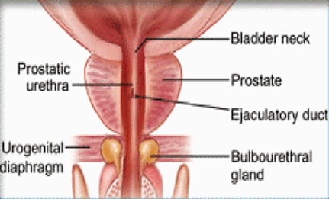
The Prostate…
Relatively easy to diagnose.
Plenty of data.
Prostate cancer is the most common form of cancer in men, other than skin cancer.

Slide 3
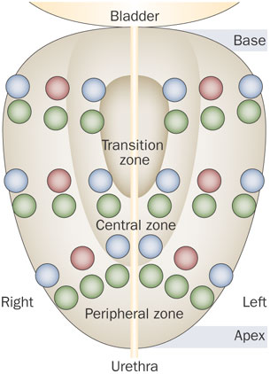
Prostate Cancer Screening
PSA Test
Palpation
Biopsy
12-130 needles

Slide 4
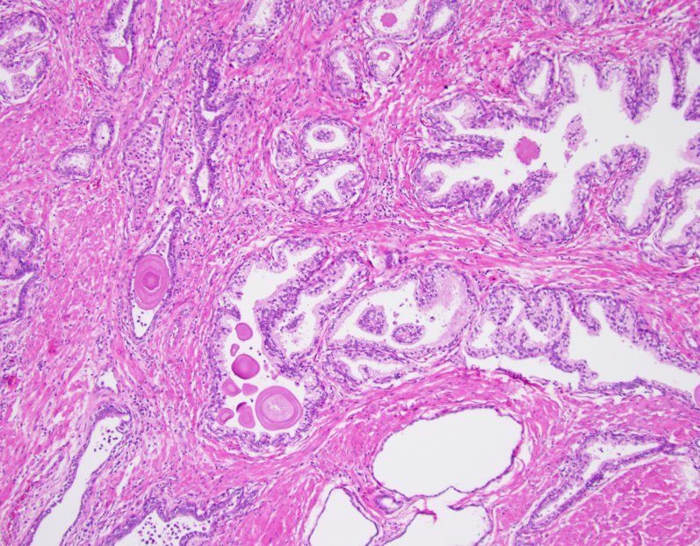
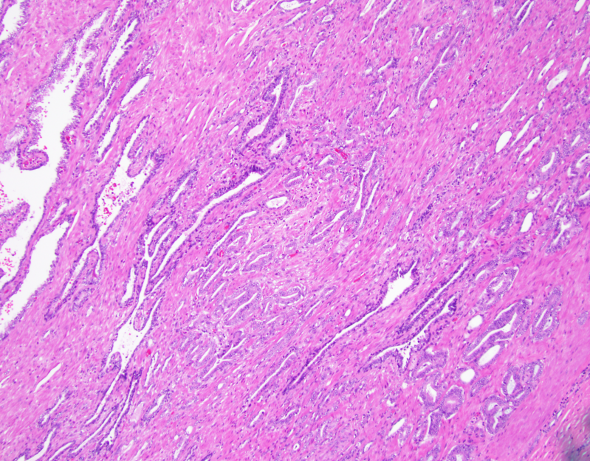
Diagnosis
36 to as many as 360 slides!
Requires a pathologist to study each slide
Highly accurate – very slow and expensive

Slide 5
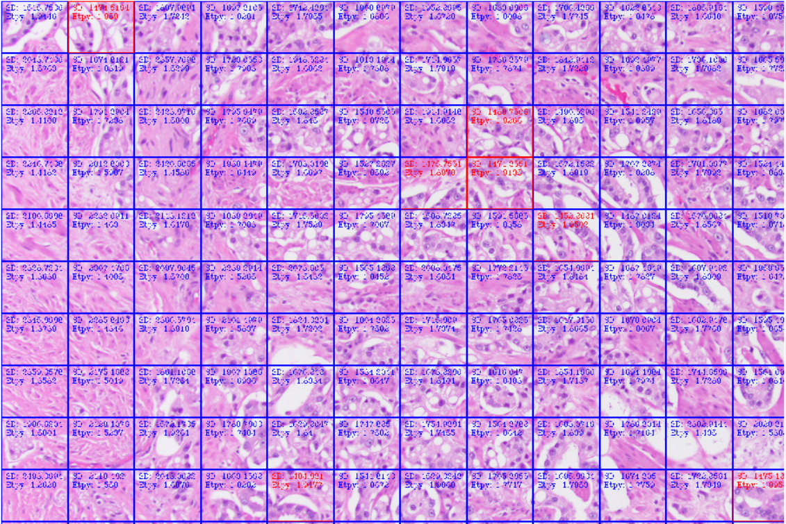
The Short-term Goal
A system to filter the data:
Flag slides with suspicious samples
Highlight suspicious regions of the image
Allow the pathologist to ignore the noise and focus her attention on the cancer.

Slide 6
Machine Learning
Programming a computer to act without having to program it specifically.
Good examples:
Voice recognition software.
Google’s self driving car.
Customer behavior prediction
Search engines

Slide 7
wndchrm
Open source utility for biological image analysis, developed by Dr. Shamir and colleagues.
Processes images through numerous algorithms to discover ‘features’, which are saved to a file.
Tests those features’ ability to classify the image.
Classifies a new image.

Slide 8
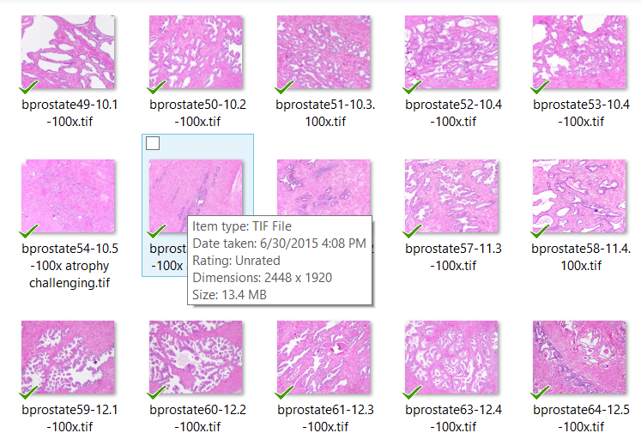
Data!
Initial Data Set:
Two sets, 100x and 200x, each 44 images
22 cancer, 22 non-cancer
Taken from cancerous prostectomy
Chosen specifically to offer a clear example of both cancerous tissue and non-cancerous tissue.

Slide 9
Whole Image Analysis
Best preliminary results
Demanding of computer resources
13.4MB
2448 x 1920

Slide 10
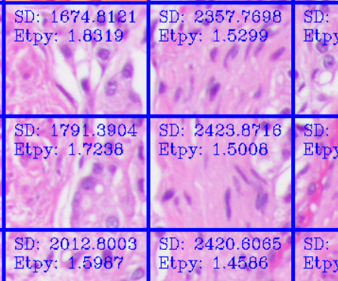
ROI Analysis
MUCH easier on CPU
Preliminary results almost as accurate as whole image analysis
Result may improve with better ROI.
OpenCV .Net C#

Slide 11
ROI Experiments
Best results with low standard deviation.
Probably only slightly better than random
I have a lot of better ideas

Slide 12
The Medium-term Goal (A truly flexible learning system)
A practical application that a pathologist can teach directly
No initial learning set
Accuracy improves with each processed and corrected image
Any type of cancer can be diagnosed
Pathologists become more productive

Slide 13
The Long-term Goal
Features
A network systems contributing to a common learning set
Rivals the accuracy of human pathologists
Features

Slide 14
Challenges
Turning tissue into images – this is still not yet practical.
Processing power – pathologists don’t have server clusters, usually.
Resistance from pathologists – other than my brother, few pathologists are eager to put themselves out of a job.
Legal issues – who gets sued if the computer misses some cancer?

Slide 15
Summary: Machine learning is an important frontier.
CPU transistors double every two years – software prowess might double every 10.
ML might be a singularity in the evolution of important software systems that solve real human problems: Google’s self-driving car and speech recognition.
Many current drivers of ML technology are superfluous: Customer behavior prediction and ads.
Currently, there is a lot of untapped data, especially in the field of biology, to which ML could be applied.

